Slide 1
Unit 4: Knowledge Representation

Slide 2
Topics Covered
Knowledge
Knowledge Representation

Slide 3
Knowledge
Knowledge is a theoretical or practical understanding of a subject or a domain.
Knowledge is also the sum of what is currently known.
Knowledge is "information combined with experience, context, interpretation, and reflection. It is a high-value form of information that is ready to apply to decisions and actions." (T. Davenport et al., 1998)
Knowledge is “human expertise stored in a person’s mind, gained through experience, and interaction with the person’s environment." (Sunasee and Sewery, 2002)

Slide 4
Knowledge
Research literature classifies knowledge as follows:
Classification-based Knowledge » Ability to classify information
Decision-oriented Knowledge » Choosing the best option
Descriptive knowledge » State of some world (heuristic)
Procedural knowledge » How to do something
Reasoning knowledge » What conclusion is valid in what situation?
Assimilative knowledge » What its impact is?
In general, knowledge is more than just data, it consist of: facts, ideas, beliefs, heuristics, associations, rules, abstractions, relationships, customs.

Slide 5
Knowledge Representation
Knowledge representation is concerned with encoding the human knowledge into the form that is efficiently manipulated by the computer.
Knowledge representation (KR) is the study of how knowledge about the world can be represented and what kinds of reasoning can be done with that knowledge.
Since knowledge is used to achieve intelligent behavior, the fundamental goal of knowledge representation is to represent knowledge in a manner as to facilitate inferencing (i.e. drawing conclusions) from knowledge.

Slide 6

Knowledge Representation
Issues:
How do people represent knowledge?
What is the nature of knowledge and how do we represent it?
Should a representation scheme deal with a particular domain or should it be general purpose?
How expressive is a representation scheme or formal language?
Should the scheme be declarative or procedural?

Slide 7
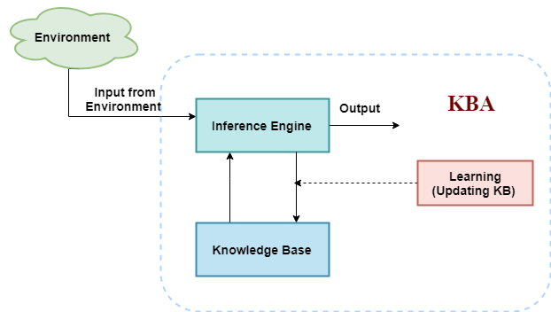
A Knowledge – Based Agent
A knowledge-based agent consists of a knowledge base (KB) and an inference engine (IE).
A knowledge-base is a set of sentences of what one knows about the world.
The Inference engine derives new sentences from the input and KB.
The agent operates as follows:
1. It receives percepts from environment
2. It computes what action it should perform (by IE and KB)
3. It performs the chosen action.

Slide 8
Properties for Knowledge Representation System
Representational Adequacy
• the ability to represent the required knowledge
Inferential Adequacy
• the ability to manipulate the knowledge represented to produce new knowledge corresponding to that inferred from the original
Inferential Efficiency
• the ability to direct the inferential mechanisms into the most productive directions by storing appropriate guides
Acquisitional Efficiency
• the ability to acquire new knowledge using automatic methods wherever possible rather than reliance on human intervention.

Slide 9
Knowledge Representation Schemes
Procedural representation scheme – if then rules
Network representation scheme – semantic networks, conceptual graphs
Structured representation scheme – scripts, frames, objects
Logical representational scheme – propositional and predicate logic

Slide 10
Topics Covered
Types of Knowledge Representation Systems:
Semantic Networks
Frames
Conceptual dependencies
Scripts
Rule based systems
Prepositional Logic
Predicate Logic

Slide 11
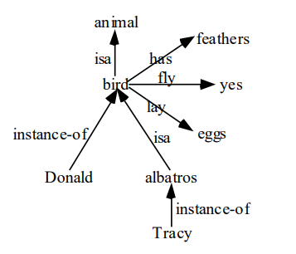
Representing knowledge in Semantic Networks
The underlying idea of semantic networks is to represent knowledge in the form of a graph in which:
nodes: represent objects, situations, or events
arcs: represent the relationships between them.
Represent the following sentences into a semantic network.
Birds are animals.
Birds have feathers, fly and lay eggs.
Albatros is a bird.
Donald is a bird.
Tracy is an albatros.

Slide 12
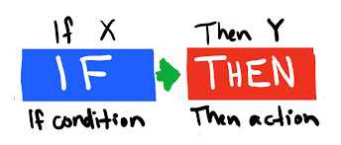
Rule Based System
A rule based system / production system (or production rule system) is a way to represent knowledge which consists primarily of a set of rules known as production.
Productions are the set of rules that consist of two parts: a sensory precondition (or "IF" statement) (antecedent) and an action (or "THEN") (consequent).

Slide 13
Rule Based System
If a production's precondition matches the current state of the world, then the production is said to be triggered. If a production's action is executed, it is said to have fired.
Productions, are a basic representation found useful in automated planning, expert systems and action selection.
Example:
If it is raining then open umbrella.
If your mark is less then study more.

Slide 14
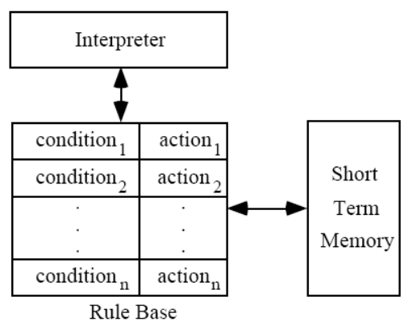
Rule Based System
Architecture of Rule Based System:
Short Term Memory: - Contains the description of the current state.
Set of Production Rules: - Set of condition-action pairs
Interpreter: - A mechanism to examine the short term memory and to determine which rules to fire (According to some strategies such as DFS, BFS, Priority, first-encounter etc)

Slide 15
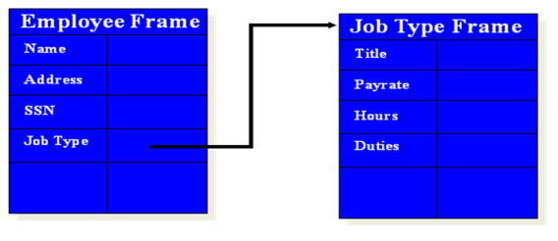
Frames
With this approach, knowledge may be represented in a data structure called a frame.
A frame is a data structure containing typical knowledge about a concept or object.
Each frame has a name and slots.
Slots are the properties of the entity that has the name, and they have values or pointer to other frames ( a table like data structure).

Slide 16
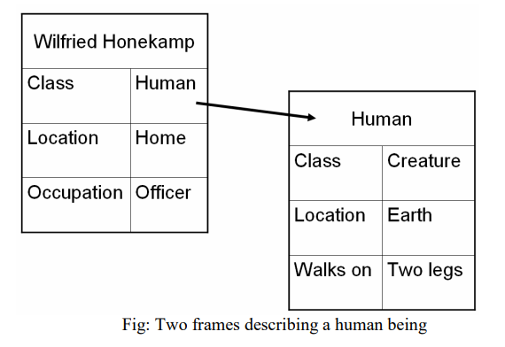
Frames
The idea of frame hierarchies is very similar to the idea of class hierarchies found in object-orientated programming.
Frames are an application of the object-oriented approach to knowledge-based systems.
A frame represents knowledge about real world things (or entities).

Slide 17
Conceptual Dependency
CD theory was developed to represent the meaning of NL sentences.
CD representation of a sentence is not built using words in the sentence rather built using conceptual primitives which gave the intended meanings of words.
CD provides structures and specific set of primitives from which representation can be built.
There are four conceptual categories:
ACT Actions
PP Objects
AA Modifiers of actions
PA Modifiers of PP’s

Slide 18
Conceptual Dependency
Primitive Acts of CD theory
ATRANS Transfer of an abstract relationship (i.e give)
PTRANS transfer of the physical location of an object (go)
MTRANS Transfer of mental information (tell)
PROPEL application of physical force to an object (push)
MOVE movement of a body part by of owner (kick)
GRASP grasping of an object by an actor (clutch)
INGEST ingestion of an object by an animal (eat)
EXPEL Expulsion of something from the body of an animal (cry)
MBUILD Building new information out of old (decide)
SPEAK production of sounds (say)
ATTEND Focusing of a sense organ toward a stimulus (listen)

Slide 19
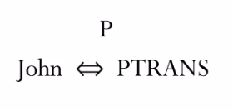
Conceptual Dependency
Rule: PP <==> ACT
It describes the relationship between an actor and the event caused by actor.
There is a two-way dependency, since neither actor nor event can be considered primary.
Example: John ran P indicates past tense.

Slide 20
Conceptual Dependency
Few conventions
O – for the object case relation
R – for the recipient case relation
P – for past tense
F – for future tense
Nil – for present tense
T – for transition

Slide 21
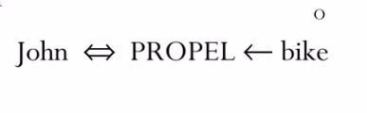
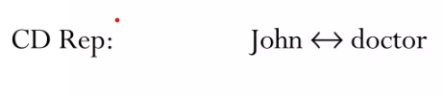
Conceptual Dependency
Rule: ACT ← PP
It describes the relationship between a ACT and a PP (object) of ACT.
Example: John pushed the bike
Rule: PP ↔ PP
It describes the relationship between two PP’s, one of which belongs to the set defined by the other.
Example: John is doctor

Slide 22
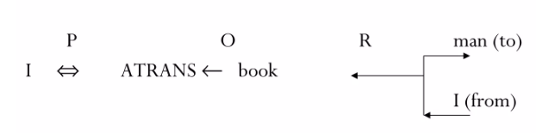
Conceptual Dependency
Example:
I gave a book to the man.
Goal:
To be independent of the words used in the original input
Same representation for different saying with same meaning. For example:
I gave the man a book.
The man got book from me.
The book was given to man by me.

Slide 23
Scripts
A script is a structure that prescribes a set of circumstances which could be expected to follow on from one another.
Scripts are used for representing knowledge about common sequences of events.
It is similar to a thought sequence or a chain of situations which could be anticipated.
Scripts use a frame-like structure to represent the commonly occurring experience like going to the movies eating in a restaurant, shopping in a supermarket, or visiting an ophthalmologist.

Slide 24
Scripts
Components of a script
Entry condition: These are basic condition which must be fulfilled before events in the script can occur.
Roles: These are the actions that the individual participants perform. Persons involved in event.
Props: Slots representing objects involved in events
Results: Condition that will be true after events in script occurred.
Track: Variations on the script. Different tracks may share components of the same scripts.
Scenes: The sequence of events that occur. Events are represented in conceptual dependency form.

Slide 25
Scripts
Script : Play in Theater
Props:
Tickets
Seat
Play
Roles:
Person(who wants to see a play) – P
Ticket Distributor – TD
Ticket Theater – TC
Entry Conditions:
P wants to see a play
P has a money
Results:
P saw a play
P has less money
P is happy (optional if he liked the play)

Slide 26
Scripts
Scene 3: Going inside hall of theater and sitting on a seat
P PTRANS P into Hall of theater
TC ATTEND eyes on ticket POSS by P
TC MTRANS (showed seat) to P
P PTRANS P to seat
P MOVES P to sitting position
Scene 4: Watching a play
P ATTEND eyes on play
P MBUILD (good moments) from play
Scene 5: Exiting
P PTRANS P out of Hall and theater
Scene 1: Going to theater
P PTRANS P into theater
P ATTEND eyes to ticket counter
Scene 2: Buying ticket
P PTRANS P to ticket counter
P MTRANS (need a ticket) to TD
TD ATRANS ticket to P

Slide 27
Scripts
Example: Script for going to the bank to withdraw money.
SCRIPT: Withdraw money
TRACK: Bank
PROPS :
Money
Counter
Form
Token
Roles :
P= Customer
E= Employee
C= Cashier
Entry conditions:
P has no or less money.
The bank is open.
Results :
P has more money.

Slide 28
Scripts
Scene 1: Entering
P PTRANS P into the Bank
P ATTEND eyes to E
P MOVE P to E
Scene 2: Filling form
P MTRANS signal to E
E ATRANS form to P
P PROPEL form for writing
P ATRANS form to P
E ATRANS form to P
Scene 3: Withdrawing money
P ATTEND eyes to counter
P PTRANS P to queue at the counter
P PTRANS token to C
C ATRANS money to P
Scene 4: Exiting the bank
P PTRANS P to out of bank

Slide 29
Logic
Logic is a formal language for representing knowledge such that conclusions can be drawn.
Logic is defined as a formal language for expressing knowledge and ways of reasoning.
Formal logic is the science of deductively valid inferences or of logical truths.
Compared to natural languages (expressive but context sensitive) and programming languages (good for concrete data structures but not expressive).
Logic combines the advantages of natural languages and formal languages.

Slide 30
Logic
The rules of logic give precise meaning to mathematical statements.
These rules are used to distinguish between valid and invalid mathematical arguments.
Therefore, it should have syntax, semantics and inference method.
Syntax: describes how sentence are formed in the LOGIC
Semantics: describes the meaning of sentences.
Inference method: set of rules for generating new sentences.

Slide 31
Logic
Examples of Logics are:
Propositional logic
Predicate logic
Fuzzy logic

Slide 32
Propositional Logic
Propositional logic represents knowledge/ information in terms of propositions.
Prepositions are facts and non-facts that can be true or false.
Propositions are expressed using ordinary declarative sentences.
Some examples of Propositions are given below :
• "Man is Mortal", it returns truth value ― TRUE
• "12 + 9 = 3 – 2", it returns truth value ― FALSE
The following sentences are not Proposition:
• "A is less than 2". It is because unless we give a specific value of A, we cannot say whether the statement is true or false.
• Also the sentences "Close the door", and "Is it hot outside ?"are not propositions.

Slide 33
Propositional Logic
Syntax:
The syntax of propositional logic defines the allowable sentences.
The atomic sentences the indivisible syntactic elements- consist of single proposition symbol.
Each such symbol stands for a proposition that can be true or false.
We use the symbols like A, B, P1, P2 to represent sentences.
• "It is cold" is represented by P
• "It is humid" is represented by Q
• "It is raining” is represented by R
The complex sentences are constructed from simpler sentences using logical connectives.

Slide 34
Formal logic – connectives:
In logic, a logical connective (also called a logical operator) is a symbol or word used to connect two or more sentences (of either a formal or a natural language) in a grammatically valid way, such that the compound sentence produced has a truth value dependent on the respective truth values of the original sentences.
Commonly used logical connectives include:
Negation (not) (¬ or ~)
Conjunction (and) (˄ , &, or · )
Disjunction (or) (V or ∨ )
Material implication (if...then) ( ͍͍→ )
Biconditional (if and only if) (iff) (↔ )

Slide 35
Formal logic – connectives:
For statement P = It is raining and Q = I am indoors.
It is raining and I am indoors (P ˄ Q)
If it is raining, then I am indoors (P V Q)
It is raining if I am indoors (Q → P)
It is raining if and only if I am indoors (P ↔ Q)
It is not raining (¬P)

Slide 36
Semantics of Propositional Logic
In propositional logic all sentences are constructed from atomic sentences and the five connectives
So semantics of propositional logic requires rules to define the truth of atomic sentences and rules to define the truth of sentences formed with each of the five connectives
Rules for evaluating truth with respect to a model:
¬ S is true if, S is false
S1 ^ S2 is true if, S1 is true and S2 is true
S1 V S2 is true if, S1 is true or S2 is true
S1 → S2 is true if, S1 is false or S2 is true
S1 ↔ S2 is true if, S1 → S2 is true and S2 → S1 is true

Slide 37
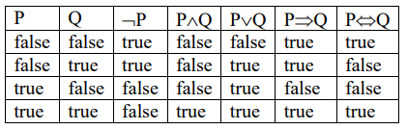
Semantics of Propositional Logic
Truth Table showing the evaluation of semantics of complex sentences:

Slide 38
Propositional Logic
Properties:
Validity(Tautology)
Satisfiability (contingency)
Un-Satisfiability (Contradictory)
Equivalent
Entailment
Soundness

Slide 39
Propositional Logic
Validity
A sentence is valid if it is true in all models,
e.g., True, A v ¬ A, A → A
Valid sentences are also known as tautologies.
Every valid sentence is logically equivalent to True
Satisfiability
A sentence is satisfiable if it is true in some model
e.g., A v B, C
Satisfiable sentences are also known as Contingency.

Slide 40
Propositional Logic
Unsatistiability
A sentence is unsatisfiable if it is true in no models
e.g., A ^ ¬ A
Un-Satisfiable sentences are also known as contradictory sentences.

Slide 41
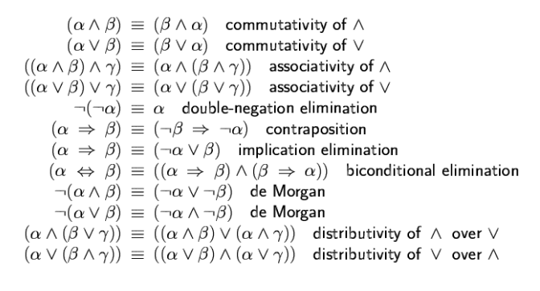
Propositional Logic
Logical euivalence
Two sentences P and Q are logically equivalent (P ≡ Q) iff true they are true in same set of models
Two sentences P and Q are logically equivalent (P ≡ Q) iff P → Q and Q → P.

Slide 42
Propositional Logic
Entailment:
Entailment means that one thing follows from another:
KB |= α
Knowledge base KB entails sentence α if and only if α is true in all worlds where KB is true
E.g., x + y =4 entails 4=x + y
Example:
Let, conclusion α = A v B and KB = (A v C) ^ (B v ¬ C)
Does KB entail α?
check all possible models; α must be true whenever KB is true

Slide 43
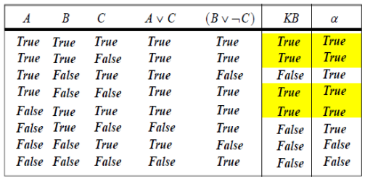
Propositional Logic
Entailment:
Therefore, KB entails α

Slide 44
Propositional Logic
Soundness:
Soundness vs Validity
A logically valid argument is one where the conclusion follows from the premises.
This is an example of a valid argument.
All fire-breathing rabbits live on Mars
All humans are fire-breathing rabbits
Therefore, all humans live on Mars
The first premise is false, yet the conclusion is still valid.
This argument is valid but not sound.
In order for a deduction to be sound, the deduction must be valid and the premise must all be true.

Slide 45
Propositional Logic
Soundness:
Soundness vs Validity
Let’s take one of the above examples.
1. All monkeys are primates
2. All primates are mammals
3. All monkeys are mammals
This is a sound argument because it is actually true in the real world.

Slide 46
Inference Method
The process by which a conclusion is drawn from given premises.
But logic is concerned with: does the truth of the conclusion follow from that of the premises?
Several basic methods for determining whether a given set of premises propositionally entails a given conclusion.
Truth Table Method(Enumeration Method)
Deductive (Proof) Systems
Resolution

Slide 47
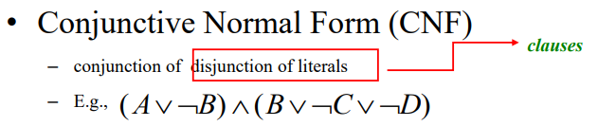
Conjunctive Normal Form (CNF)
A sentence that is expressed as a conjunction of disjunctions of literals is said to be in conjunctive normal form (CNF).
Remember:
A literal is either an atomic sentence or a negation of an atomic sentence. For e.g. p, ¬p
A clause expression is either a literal or a disjunction of literals. For e.g. p, ¬p, p v q

Slide 48
Conversion to CNF
Algorithm:
Eliminate ↔ rewriting P↔Q as (P→Q)∧(Q→P)
Eliminate → rewriting P→Q as ￢P∨Q
Use De Morgan’s laws to push ￢ inwards:
- rewrite ￢(P∧Q) as ￢P∨￢Q
- rewrite ￢(P∨Q) as ￢P∧￢Q
Eliminate double negations:
rewrite ￢￢P as P
Use the distributive laws to get CNF:
- rewrite (P∧Q)∨R as (P∨R)∧(Q∨R)
Flatten nested clauses:
- (P∧Q) ∧ R as P∧Q ∧ R - (P∨Q)∨R as P∨Q∨R

Slide 49
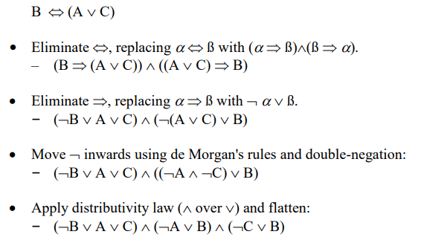
Conversion to CNF
Example:
Let’s illustrate the conversion to CNF by using an example. B ↔ (A ∨ C)

Slide 50
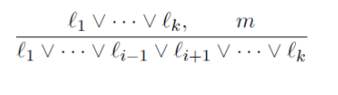
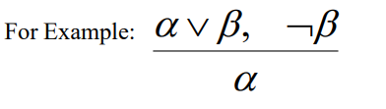
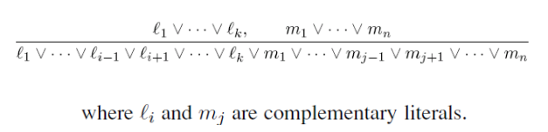
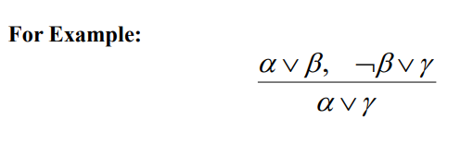
Inference using Resolution
Unit Resolution rule: This rule takes a clause (a disjunction of literals) and a literal and produces a new clause. Single literal is also called unit clause.
Generalized resolution rule: This rule takes two clauses of any length and produces a new clause as below.

Slide 51
Proof by Resolution
Resolution algorithm
Convert KB into CNF
Add negation of sentence to be entailed into KB i.e. (KB ∧ ￢ α )
Then apply resolution rule to resulting clauses.
The process continues until:
There are no new clauses that can be added
Hence KB does not entail α
Two clauses resolve to entail the empty clause.
Hence KB does entail α

Slide 52
Proof by Resolution
Example:
Illustrate the conversion to CNF: (B ↔ (A ∨ C)) ∧￢ B
Now, prove that A can be inferred from above KB by using resolution.

Slide 53
Proof by Resolution
Example:
Given a KB= {(G∨H) → (￢J ∧￢K), G}. Show that KB entails ￢J.
Solution:
Clausal form of (G∨H) → (￢J ∧￢K) is {￢G∨￢J, ￢H ∨￢J, ￢G∨￢K, ￢H ∨￢K}
￢G∨￢J [Premise]
￢H ∨￢J [Premise]
￢G∨￢K [Premise]
￢H ∨￢K [Premise]
G [Premise]
J [￢ Conclusion]
￢G [1, 6 Resolution]
_ [5, 7 Resolution]
Hence KB entails ￢J

Slide 54
Proof by Resolution
Given the following hypotheses:
1. If it rains, Joe brings his umbrella
2. If Joe has an umbrella, he doesn't get cold
3. If it doesn't rain, Joe doesn't get cold
Prove that Joes doesn't get cold
Represent using Propositional logic:
If it rains, Joe brings his umbrella (r -> u)
If Joe has an umbrella, he doesn't get cold (u -> ￢c)
If it doesn't rain, Joe doesn't get cold (￢r -> ￢c)
To prove: Joes doesn't get cold (￢c)

Slide 55
Proof by Resolution
We first put each hypothesis in CNF:
r -> u = (￢ r ∨ u)
u -> ￢ c = (￢ u ∨ ￢ c)
￢ r -> ￢ c = (r ∨￢ c)
Applying resolution
￢ r ∨ u (Premise)
￢ u ∨ ￢ c (Premise)
r ∨ ￢ c (Premise)
c (Negation of conclusion)
￢ r ∨ ￢ c (Using resolution on 1, 2)
￢c ∨ ￢c (Using resolution on 3, 5)
￢ c (Using resolution on 4, 6)
(Using resolution on 4, 7)

Slide 56
Proof by Resolution
# Consider a KB containing following statements:
If it is sunny and warm day you will enjoy.
If it is warm and pleasant day you will do strawberry picking
If it is raining then you will not do strawberry picking
If it is raining you will get cold
It is warm day
It is raining
It is sunny
Now infer that: you will not do strawberry picking.

Slide 57
Proof by Resolution
# Consider a KB containing following statements:
If it is raining then it is not cold.
John is not wearing a coat if it is not raining.
It is cold.
There are clouds in the sky or it is not raining.
The moon is made of cheese and there are clouds in the sky
Using resolution infer that: it is raining and John is not wearing a coat.

Slide 58
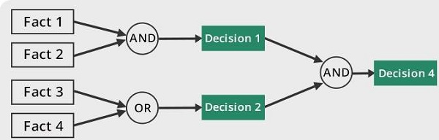
Forward and Backward Chaining
Forward chaining:
Forward chaining is a form of reasoning which start with facts in the knowledge base and applies inference rules in the forward direction to extract more data until a goal is reached.
It is a bottom-up approach
Forward chaining is known as data-driven inference technique as we reach to the goal using the available data.
Idea: fire any rule whose premises are satisfied in the KB,
– add its conclusion to the KB, until query is found
P -> Q
L ∧ M -> P
B ∧ L -> M
A ∧ P -> L
A ∧ B -> L
A
B Prove Q can be inferred

Slide 59
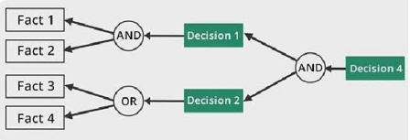
Forward and Backward Chaining
Backward chaining:
Backward chaining starts from the goal and works backward through inference rules to find the required facts that support the goal.
It is a top-down approach.

Slide 60
Forward and Backward Chaining
Backward chaining:
P -> Q
L ∧ M -> P
B ∧ L -> M
A ∧ P -> L
A ∧ B -> L
A
B
Prove Q can be inferred
Solution:
We know P -> Q, Try to prove P
L ∧ M -> P Try to prove L and M
B ∧ L -> M
A ∧ P -> L
Try to prove B, L and A and P
A and B is already known
Since A ∧ B -> L L is also known
Since, B ∧ L -> M M is also known
Since, L ∧ M -> P P is known, hence the proved.

Slide 61
Predicate Logic
Predicate Logic is a more powerful logic (use foundation of propositional logic) by adding more expressive concepts.
Propositional logic is limited in several ways:
Propositional logic is declarative
Propositional logic is compositional:
o meaning of B ∧ P is derived from meaning of B and of P
Propositional logic has very limited expressive power
o (unlike natural language)

Slide 62
Predicate Logic
Propositional logic assumes the world contains facts, whereas first-order logic (like natural language) assumes the world contains:
Objects: which are things with individual identities people, houses, companies…
Properties: that distinguish objects from others blue, oval, even, large, ...
Relations: that hold among sets of objects brother of, bigger than, part of, comes between,…
Functions: which are a subset of relations where there is only one ―value‖ for any given―input‖ father of, best friend, one more than, plus, …

Slide 63
Representing knowledge in predicate logic
Quantifiers
Allows us to express properties of collections of objects.
Two quantifiers are:
Universal: “for all”: ∀
Existential: “there exists” : ∃

Slide 64
FOPL: Semantic
An interpretation is required to give semantics to first-order logic.
The interpretation is a non-empty “domain of discourse” (set of objects).
The truth of any formula depends on the interpretation.
The interpretation provides, for each:
constant symbol : an object in the domain
function symbols : a function from domain tuples to the domain
predicate symbol : a relation over the domain (a set of tuples)
Then we define:
universal quantifier ∀xP(x) is True iff P(a) is True for all assignments of domain elements a to x
existential quantifier ∃xP(x) is True iff P(a) is True for at least one assignment of domain element a to x

Slide 65
FOPL: Inference (Inference in predicate logic)
Universal Instantiation and Existential Instantiation
First order inference can be done by converting the knowledge base to PL and using propositional inference.
– How to convert universal quantifiers?
– Replace variable by ground term.
– How to convert existential quantifiers?
– Skolemization.
Universal instantiation (UI)
Substitute ground term for the variables.
For example consider the following KB
∀x King (x) ∧ Greedy (x) -> Evil(x)
put, x = John, Richard, …..
It’s UI is : King (John) ∧ Greedy (John) -> Evil(John)
King (Richard) ∧ Greedy (Richard) -> Evil(Richard)
Note: Remove universally quantified sentences after universal instantiation.

Slide 66
FOPL: Inference (Inference in predicate logic)
Universal Instantiation and Existential Instantiation
Existential Instantiation
EI rule: the variable is replaced by a single new constant symbol does not appear elsewhere in the knowledge base.
E.g.: Consider the sentence
∃x Crown(x) ∧ OnHead(x, John)
After EI: Crown(C1) ∧ OnHead(C1, John) where C1 is Skolem Constant.
Also known as Skolemization

Slide 67
Conversion to CNF
Eliminate implications and bi-implications as in propositional case
Move negations inward using De Morgan’s laws
plus rewriting ￢∀xP as ∃x￢P and ￢∃xP as ∀x￢P
3. Eliminate double negations
4. Rename bound variables if necessary so each only occurs once
e.g. ∀xP(x) ∨ ∃xQ(x) becomes ∀xP(x) ∨ ∃yQ(y)
5. Use equivalences to move quantifiers to the left
e.g. ∀xP(x) ∧ Q becomes ∀x (P(x) ∧ Q) where x is not in Q
e.g. ∀xP(x) ∧ ∃yQ(y) becomes ∀x∃y(P(x) ∧ Q(y))
6. Skolemise (replace each existentially quantified variable by a new term)
∃xP(x) becomes P(a0) using a Skolem constant a0 since ∃x occurs at the outermost level
∀x∃yP(x, y) becomes P(x, f0(x)) using a Skolem function f0 since ∃y occurs within ∀x
7. The formula now has only universal quantifiers and all are at the left of the formula: drop them
8. Use distribution laws to get CNF and then clausal form

Slide 68
Acting under Uncertainty
Agents may need to handle uncertainty, whether due to partial observability, nondeterminism, or a combination of the two.
An agent may never know for certain what state it’s in or where it will end up after a sequence of actions.
Scenario:
Suppose, for example, that an automated taxi, it has the goal of delivering a passenger to the airport on time.
The agent forms a plan, A₉₀, that involves leaving home 90 minutes before the flight departs and driving at a reasonable speed.
Even though the airport is only about 5 miles away, a logical taxi agent will not be able to conclude with certainty that “Plan A90 will get us to the airport in time.”
The agent’s knowledge cannot guarantee any of these outcomes for A₉₀, but it can provide some degree of belief that they will be achieved
The right thing to do—the rational decision—therefore depends on both the relative importance of various goals and the likelihood that, and degree to which, they will be achieved.

Slide 69
Handling Uncertainty
Instead of providing all condition, it can express with degree of beliefs in the relevant sentences.
Example: Say we have a rule
if toothache then problem is cavity
But not all patients have toothaches because of cavities (although perhaps most do)
So we could set up rules like
if toothache and not(gum disease) and not(filling) and ......then problem is cavity
This gets very complicated! a better method would be to say if toothache then problem is cavity with probability 0.8
Given the available evidence, A₉₀ will get me there on time with probability 0.04
A most important tool for dealing with degree of beliefs is probability theory, which assigns to each sentence a numerical degree of belief between 0 & 1.
Making decisions under uncertainty:
P(A₉₀ gets me there in time|…. ) = 0.70

Slide 70
Handling Uncertainty
Basic Statistical methods – Probability:
The basic approach statistical methods adopt to deal with uncertainty is via the axioms of probability:
Probabilities are (real) numbers in the range 0 to 1.
A probability of P(A) = 0 indicates total uncertainty in A,
P(A) = 1 total certainty and values in between some degree of (un)certainty

Slide 71
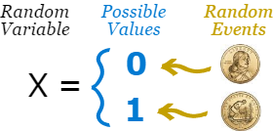
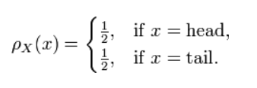
Random Variables
In probability theory and statistics, a random variable (or stochastic variable) is a way of assigning a value (often a real number) to each possible outcome of a random event
Intuitively, a random variable can be thought of as a quantity whose value is not fixed, but which can take on different values
For example:
There are two possible outcomes for a coin toss: heads, or tails.
The possible outcomes for one fair coin toss can be described using the following random variable:
and if the coin is equally likely to land on either side then it has a probability mass function given by:

Slide 72
Random Variables
Random Variable domain are: Boolean, Discrete and Continuous
Boolean
Cavity = false, toothache = true
Discrete random variables
e.g., Weather is one of (sunny, rain, cloudy, snow) Weather = rain is a proposition
Continuous random variables
e.g., Temp = 21.6, also allow, e.g., Temp < 22.0.

Slide 73
Random Variables
The prior or unconditional probability associated with a proposition is the degree of belief accorded to it in the absence of any other information.
Example:
P(Weather= sunny) = 0.72
P(Weather= rain) = 0.1
P(Weather= cloudy) = 0.08
P(Weather= snow) = 0.1
Probability distribution gives values for all possible assignments: P(Weather) = (0.72, 0.1, 0.08, 0.1)

Slide 74
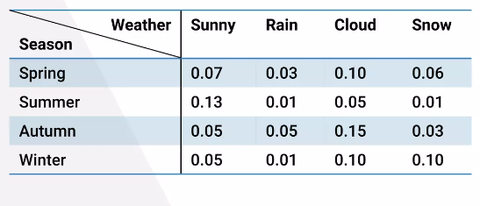
Random Variables
Joint distribution is based on joint probability, which can be simply defined as the probability of two events (variables) happening together.
These two events are usually coined event A and event B, and can formally be written as: p(A and B)
P(Weather, Season) = a 4 ×4 matrix of values.

Slide 75
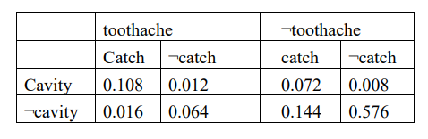
Inference using full joint distribution
The probability of any proposition event can be computed from the full joint distribution.
The probabilities in the joint distribution must sum to 1.
We consider the following domain consisting of three Boolean variables: Toothache, Cavity, and Catch (the dentist’s nasty steel probe catches in my tooth).
The full joint distribution is the following 2x2x2 table:
Simply identify those possible worlds in which the proposition is true and add up their probabilities.
For example, there are six possible worlds in which cavity ∨ toothache holds:
P(cavity ∨ toothache) = 0.108 + 0.012 + 0.072 + 0.008 + 0.016 + 0.064 = 0.28

Slide 76
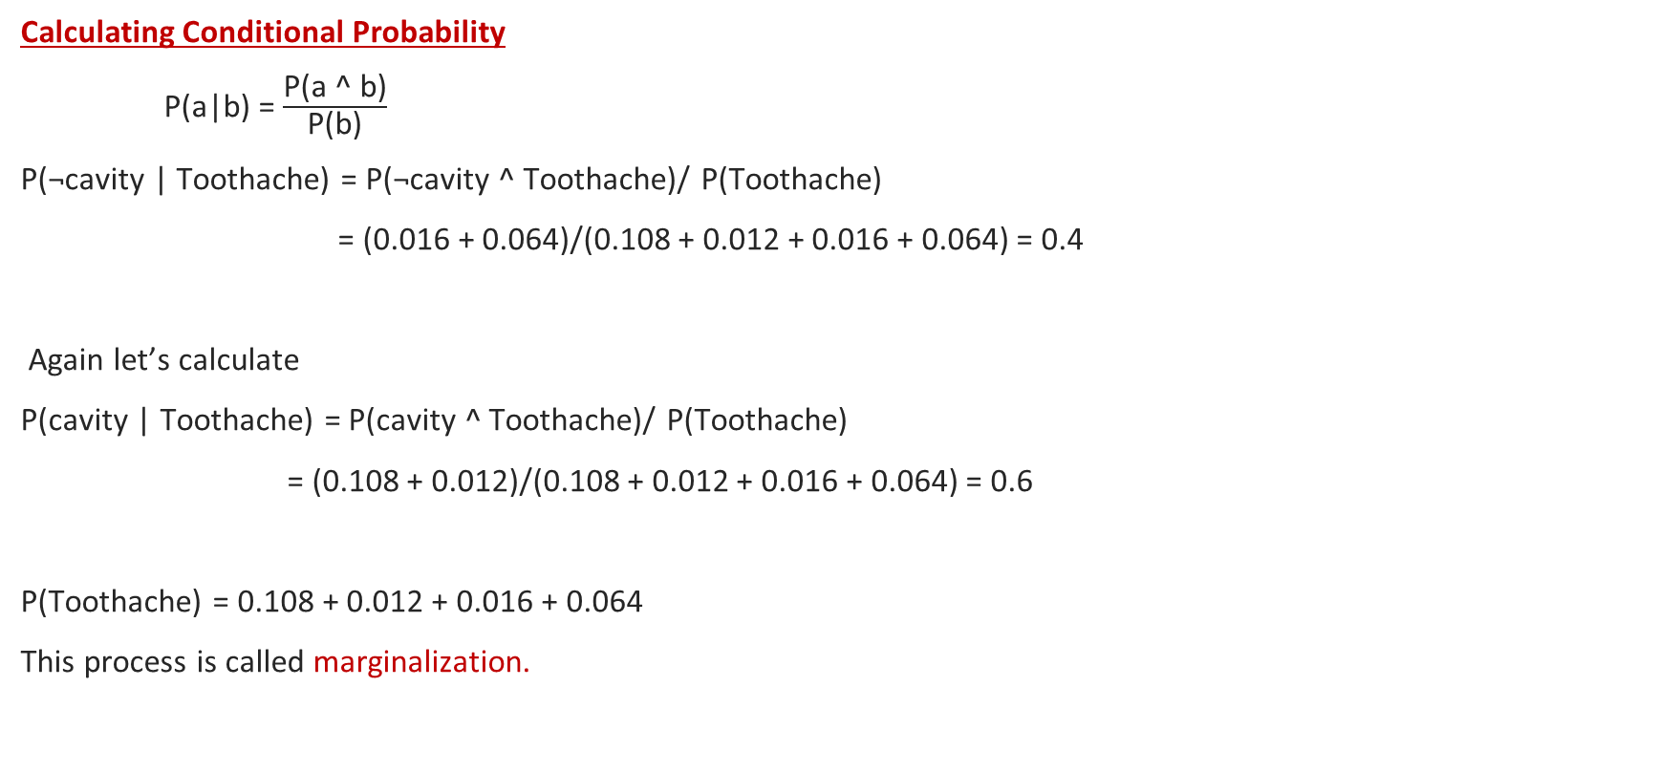
Inference using full joint distribution
Calculating Conditional Probability
P(a|b) = $\frac{\text{P}\text{(}\text{a}\text{ ^ }\text{b}\text{)}}{\text{P}\text{(}\text{b}\text{)}}$
P(¬cavity | Toothache) = P(¬cavity ^ Toothache)/ P(Toothache)
= (0.016 + 0.064)/(0.108 + 0.012 + 0.016 + 0.064) = 0.4
Again let’s calculate
P(cavity | Toothache) = P(cavity ^ Toothache)/ P(Toothache)
= (0.108 + 0.012)/(0.108 + 0.012 + 0.016 + 0.064) = 0.6
P(Toothache) = 0.108 + 0.012 + 0.016 + 0.064
This process is called marginalization.

Slide 77
Independence
P(Toothache | sunny) = P(Toothache)
P(X | Y ) = P(X)
P(Y | X) = P(Y )
P(X^ Y ) = P(X)P(Y )

Slide 78

Bayes’ Rule
Case of conditional dependence
P(a ∧ b) = P(a | b)P(b) and P(a ∧ b) = P(b | a)P(a)
Equating the two right-hand sides and dividing by P(a), we get
P(b | a) = $\frac{\text{P}\text{(}\text{a}\text{ | }\text{b}\text{)}\text{P}\text{(}\text{b}\text{)}}{\text{P}\text{(}\text{a}\text{)}}$
Applying Bayes’ rule:
P(cause | effect) = $\frac{\text{P}\text{(}\text{effect}\text{ | }\text{cause}\text{)}\text{P}\text{(}\text{cause}\text{)}}{\text{P}\text{(}\text{effect}\text{)}}$

Slide 79
Bayes’ rule
A doctor knows that the disease meningitis causes the patient to have a stiff neck 70% of the time. The doctor also knows that the probability that a patient has meningitis is 1/50,000, and the probability that any patient has a stiff neck is 1%.
Find the probability that a patient with a stiff neck has meningitis.
Here, we are given;
p(s|m) = 0.7
p(m) = 1/50000
p(s) = 0.01
Now using Bayes’ rule;
P(m|s) = P(s|m)P(m)/P(s) = (0.7*1/50000)/(0.01) = 0.0014

Slide 80
Bayesian Networks
Bayesian networks:
A data structure to represent the dependencies among variables and to give a concise specification of any full joint probability distribution.
Also called belief networks or probabilistic network or casual network or knowledge map.
A Bayesian network is a directed acyclic graph which consists of:
A set of random variables which makes up the nodes of the network.
A set of directed links (arrows) connecting pairs of nodes. If there is an arrow from node X to node Y, X is said to be a parent of Y.
Each node Xi has a conditional probability distribution P(Xi| Parents(Xi)) that quantifies the effect of the parents on the node.
A link from X to Y means that X has a direct influence on Y.

Slide 81
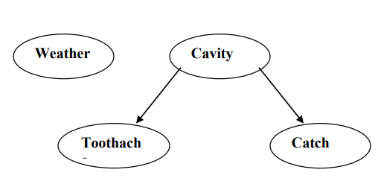
Bayesian Networks
Our existing simple world of variables toothache, cavity, catch & weather is represented as:
Weather is independent of the other variables
Example:
You have a burglar alarm installed in your home. It is fairly reliable at detecting a burglary, but also responds on occasion to minor earthquakes. You also have two neighbors, John and Mary, who have promised to call you at work when they hear the alarm. John always calls when he hears the alarm, but sometimes confuses the telephone ringing with the alarm and calls then, too. Mary, on the other hand, likes rather loud music and sometimes misses the alarm altogether.

Slide 82
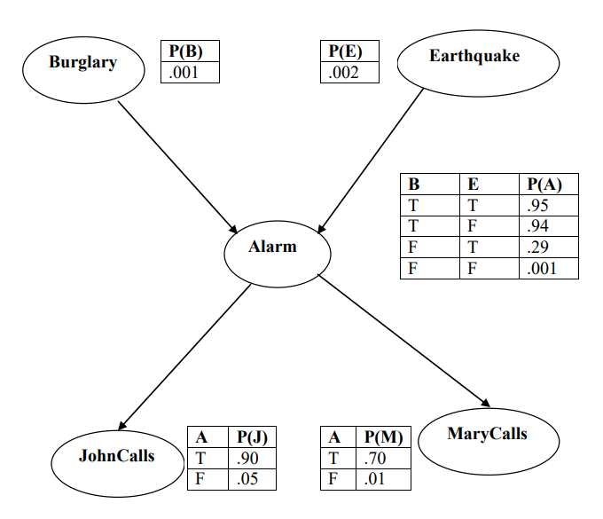
Bayesian Networks
Variables: Burglary, Earthquake, Alarm, JohnCalls, MaryCalls

Slide 83
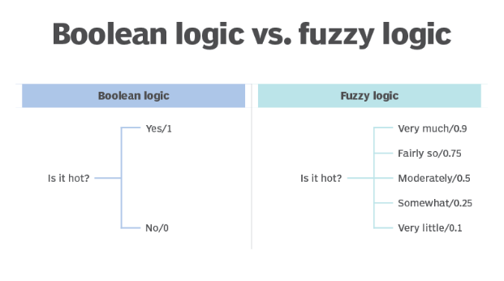
Fuzzy Logic
The term fuzzy refers to things that are not clear or are vague.
In the real world many times we encounter a situation when we can’t determine whether the state is true or false, their fuzzy logic provides very valuable flexibility for reasoning.
Compared to traditional binary sets (where variables may take on true or false values) fuzzy logic variables may have a truth value that ranges in degree between 0 and 1.

Slide 84
Fuzzy Logic
It deals with reasoning that is approximate rather than fixed and exact.
Fuzzy logic is based on the observation that people make decisions based on imprecise and non-numerical information.
Example: If temperature is high , set speed to high.
Crisp – Clear, either 0 or 1
Fuzzy – not clear
Linguistic Variables:
By a linguistic variable we mean a variable whose values are words or sentences in a natural or artificial language.
A numerical variable takes numerical values: Age = 65. While, a linguistic variables takes linguistic values: Age is old
T(age) = {young, not young, very young, ...middle aged, not middle aged, ...old, not old, very old, more or less old, ...not very young and not very old, ...}

Slide 85
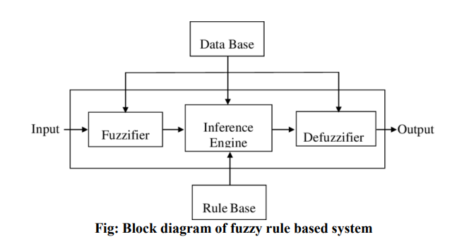
Fuzzy Logic
Fuzzy Rule-based are rule-based systems, where fuzzy sets and fuzzy logic are used as tools for representing different forms of knowledge about the problem at hand.
The fuzzifier converts real numbers of inputs into fuzzy sets.
The knowledge base includes a fuzzy rule-base and a database. Membership functions of the linguistic terms are contained in the database. The rule base consists of if then rules, which represents the relationship between input and output variables.
The defuzzifier converts fuzzy value back to real world crisp values.

Slide 86
Thank you!

